Slide 1
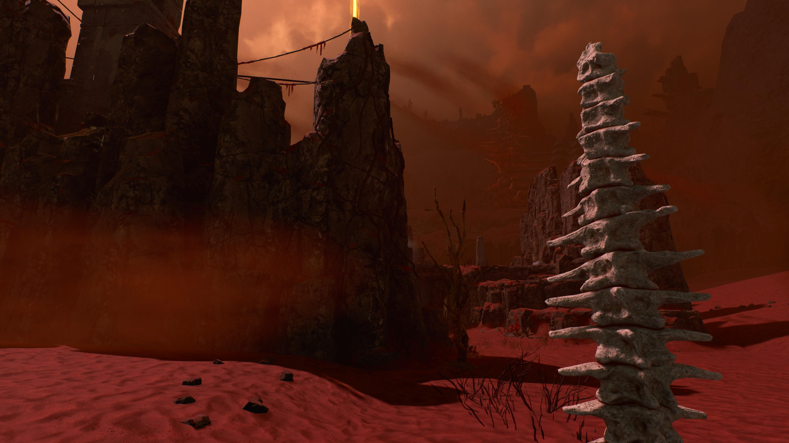

Fractured Mythology: Classical Reception and Player Mythopoesis in Housemarque’s Returnal
Scan the QR code or go to zbelliott.github.io/ReturnalMythopoesis for a copy of the paper’s text and powerpoint.
Zachary Elliott
University of Pennsylvania

Slide 2
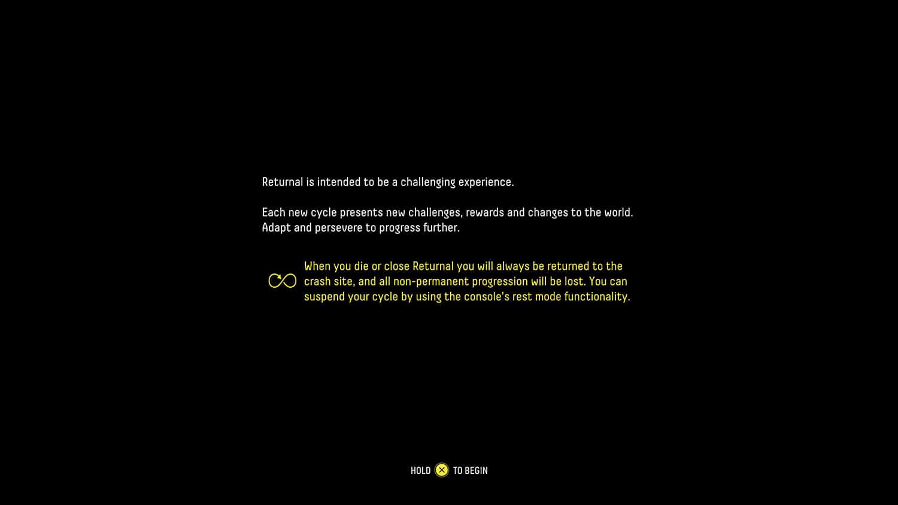

Slide 3
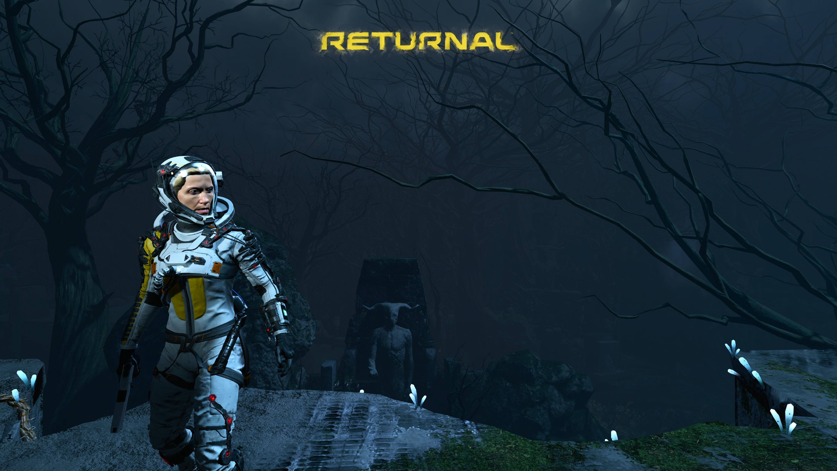

Slide 4
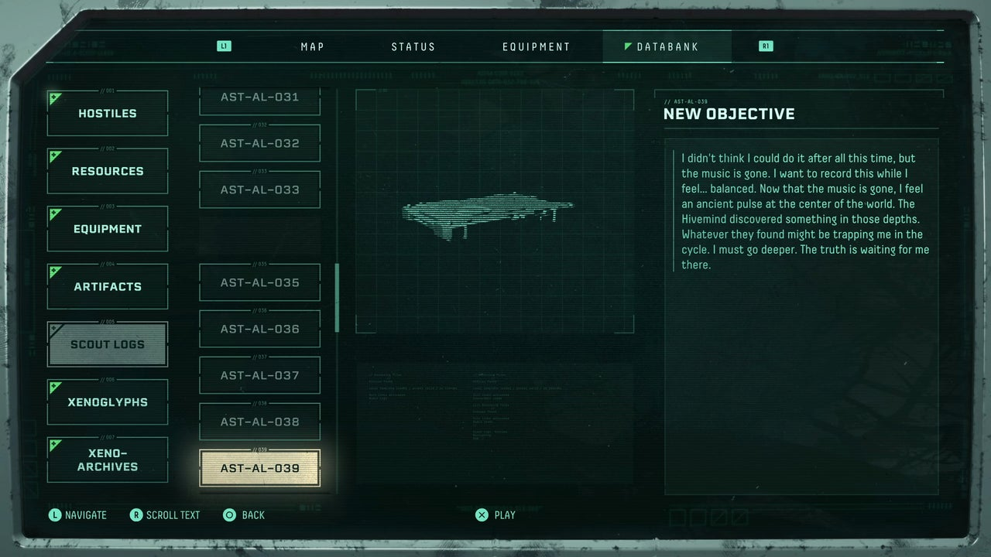

Slide 5
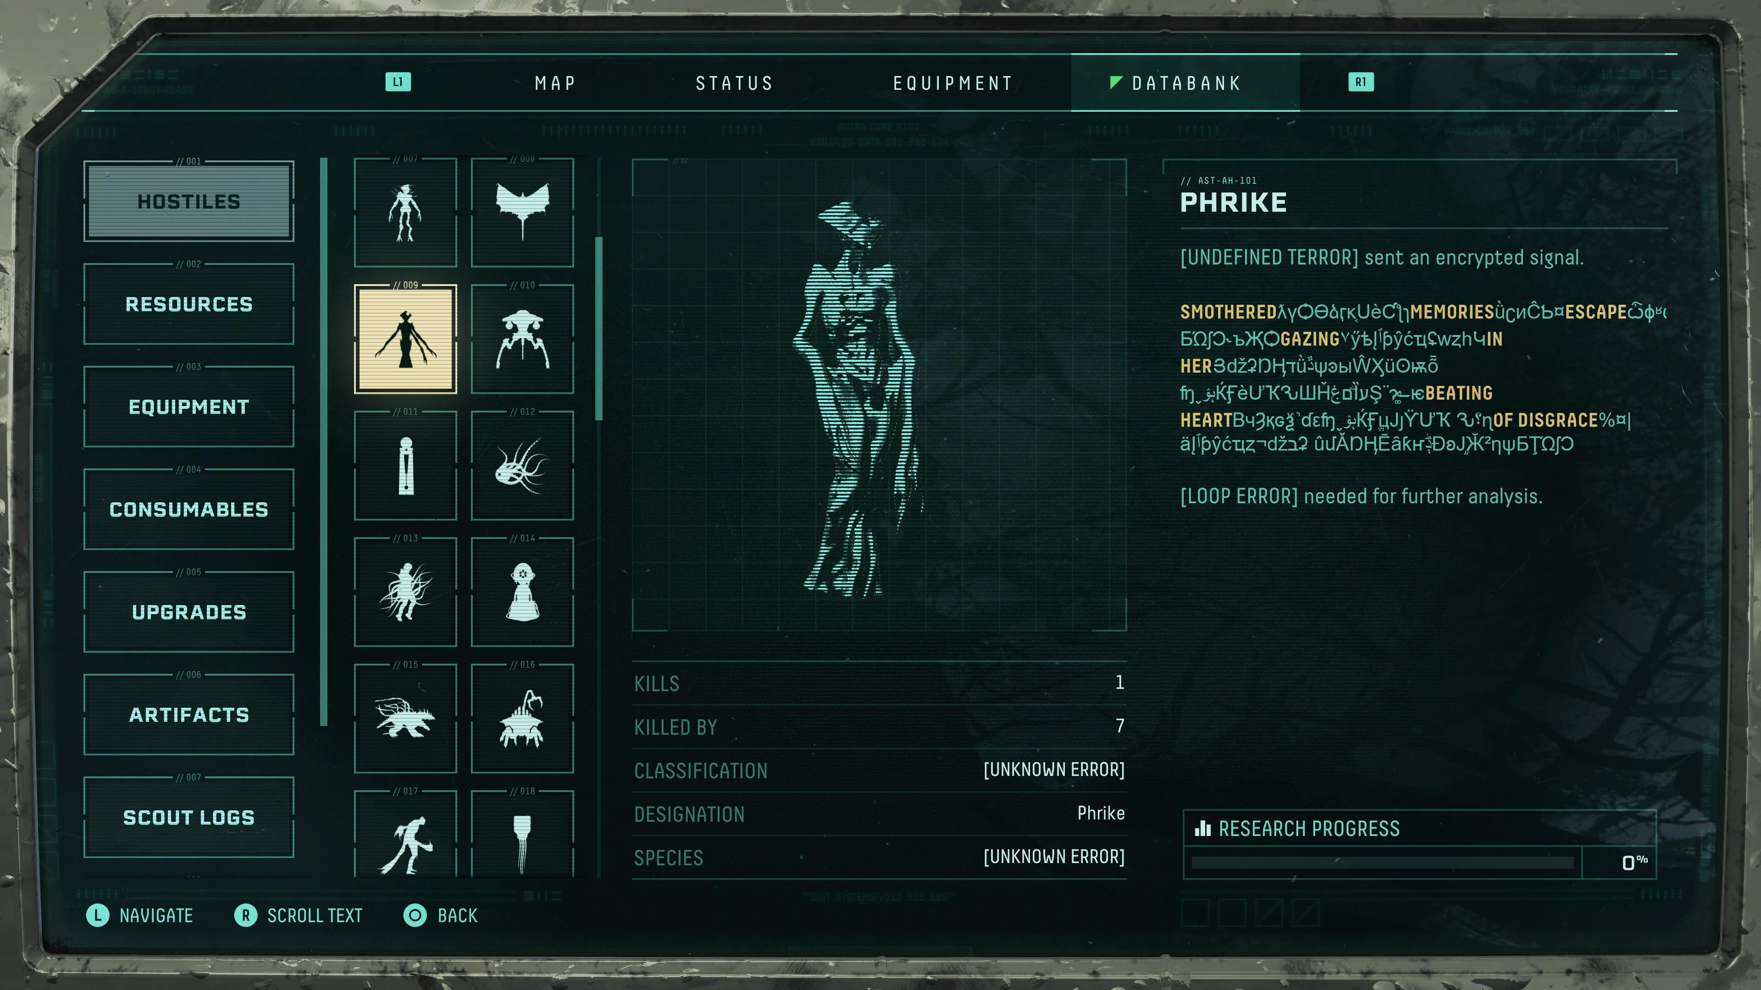

Slide 6
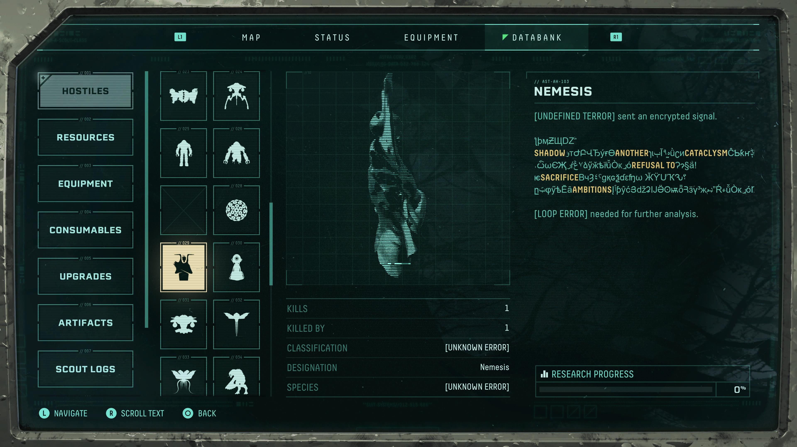

Slide 7
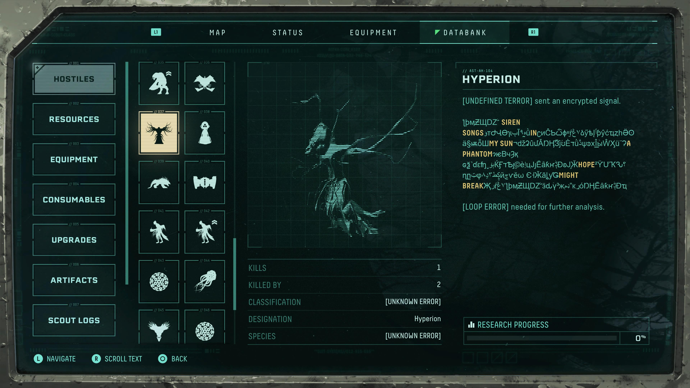

Slide 8


Slide 9
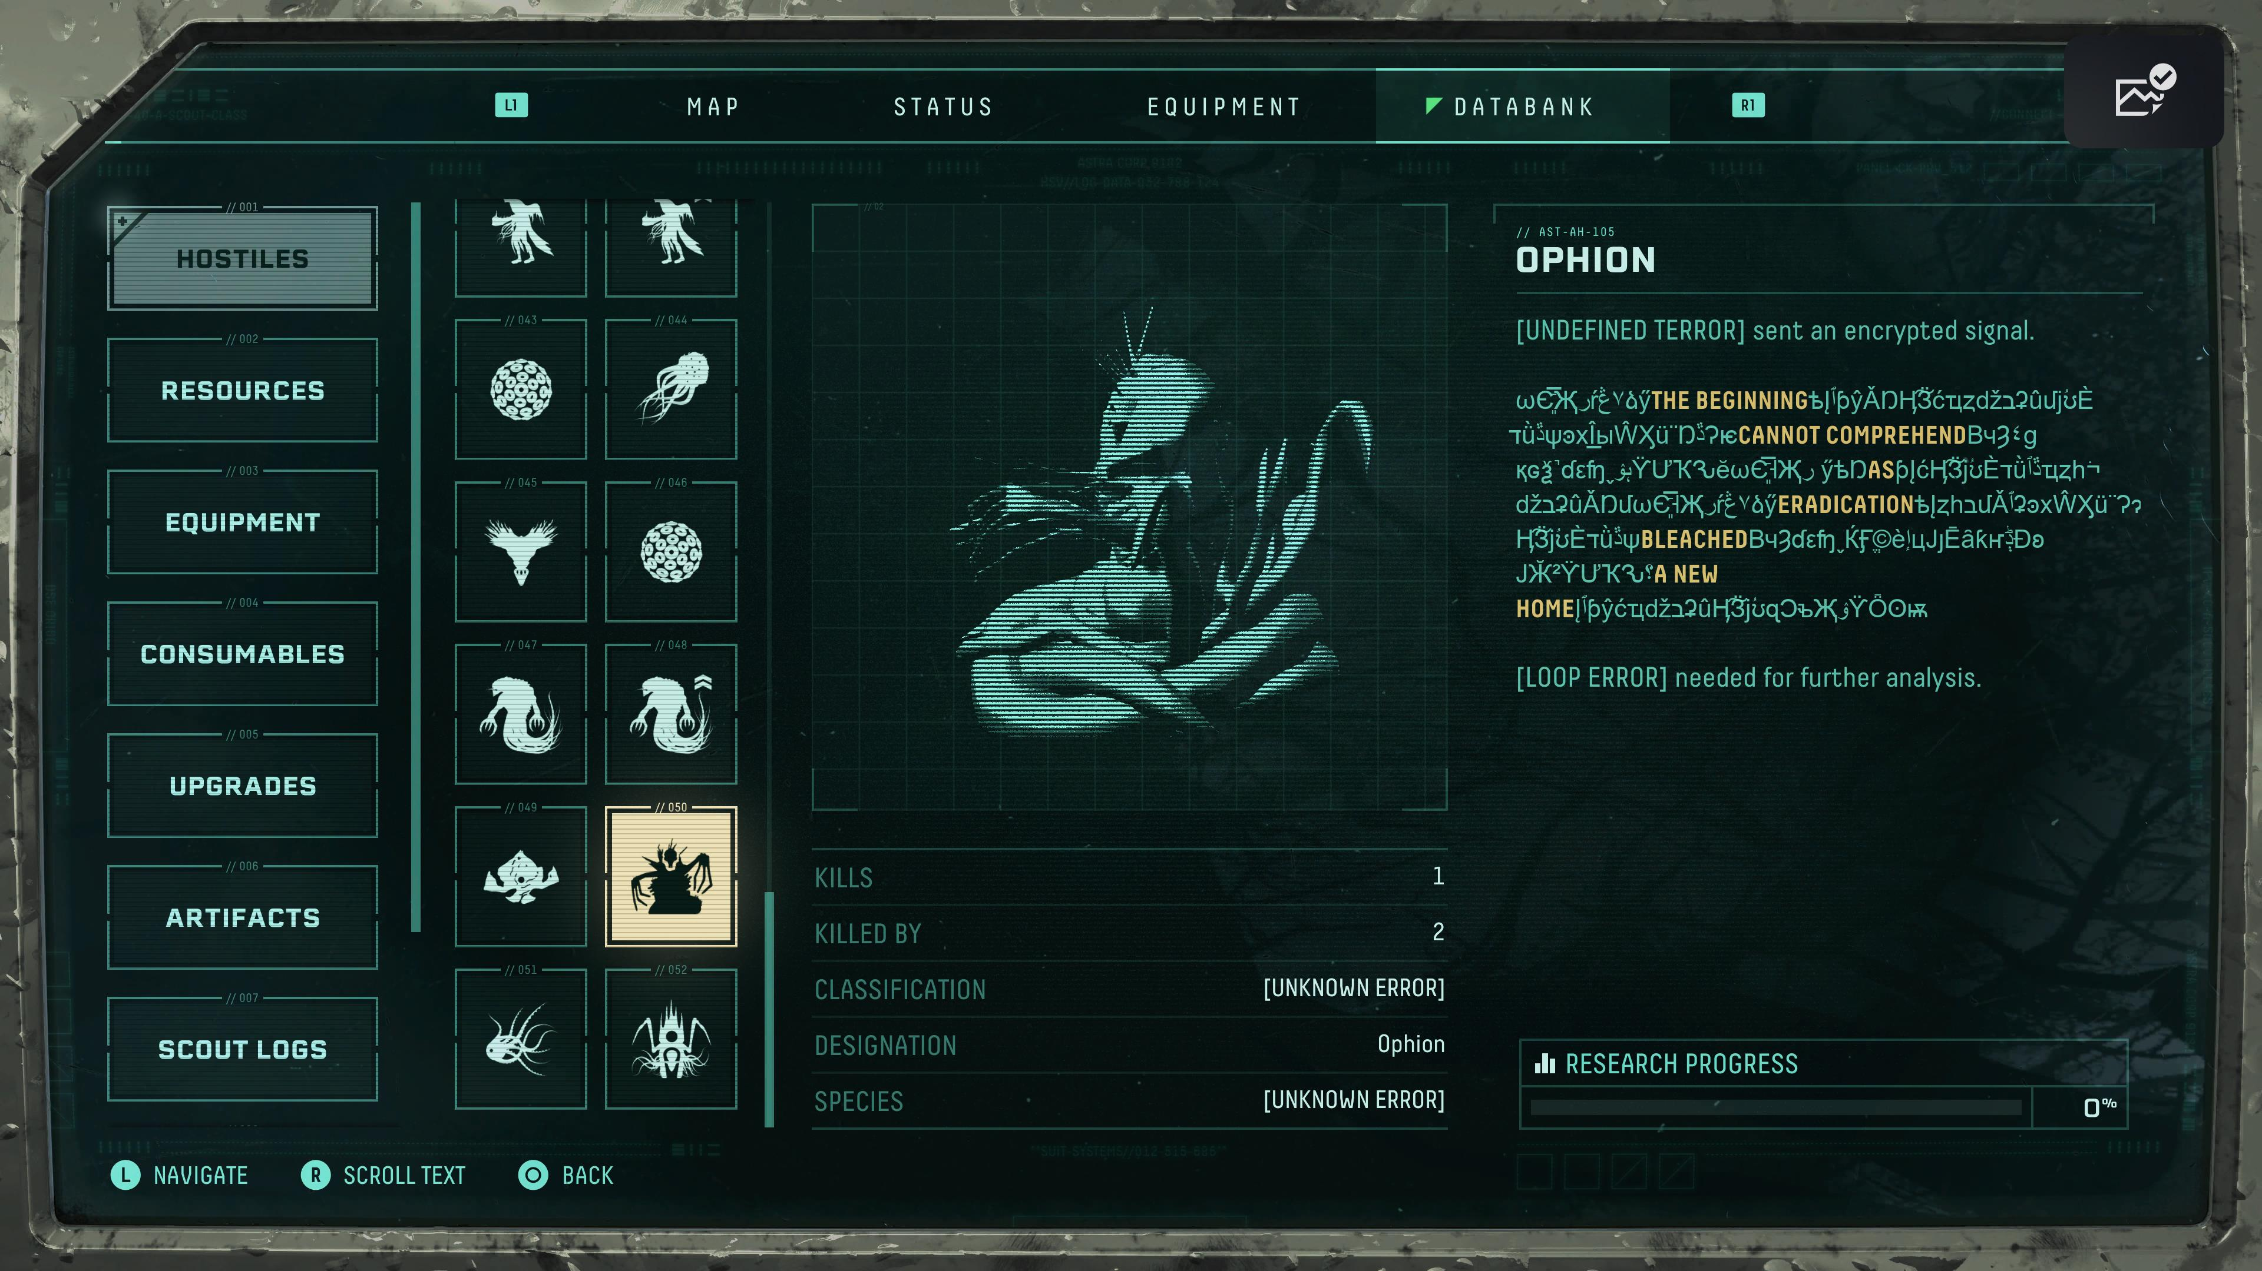

Slide 10
Signal partially decrypted. "Smothered fire. Suffocating memories. Promised
places.
Terminal escape. Gehenna. Helheim. Tartarus."

Slide 12


Slide 13
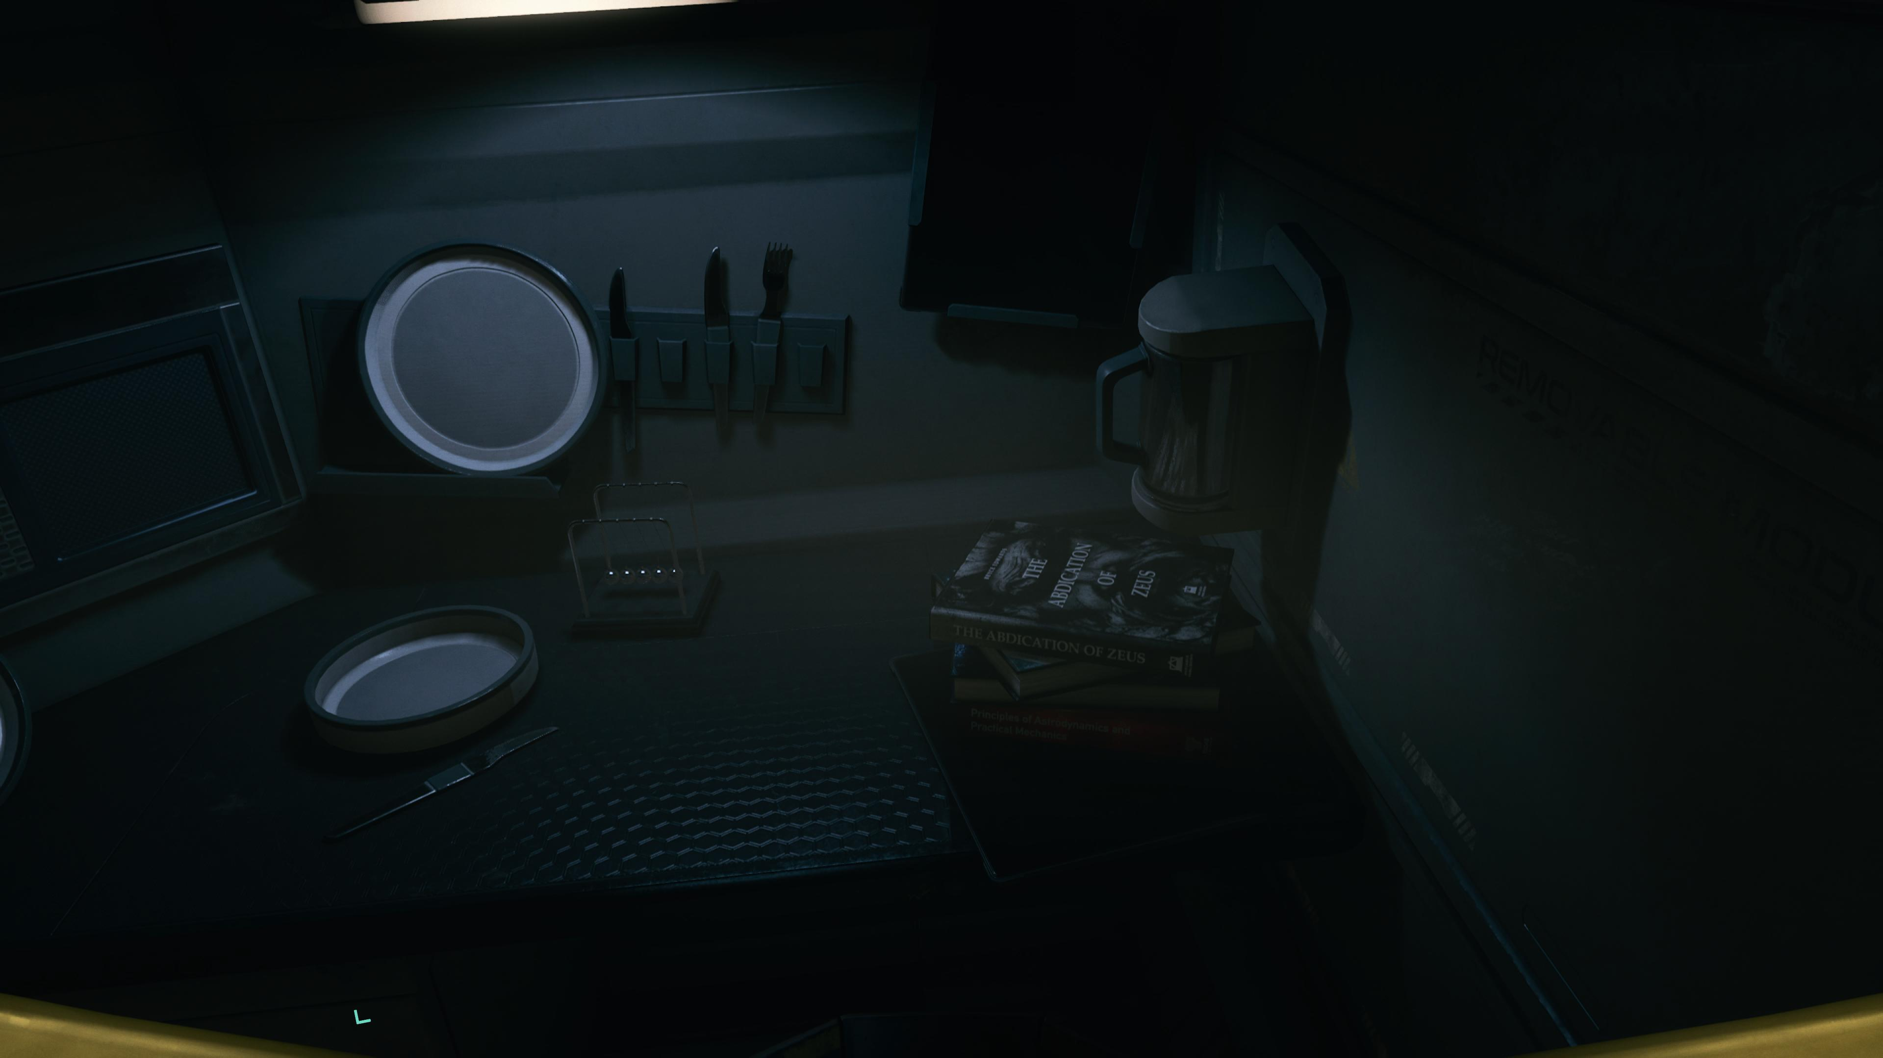

Slide 14
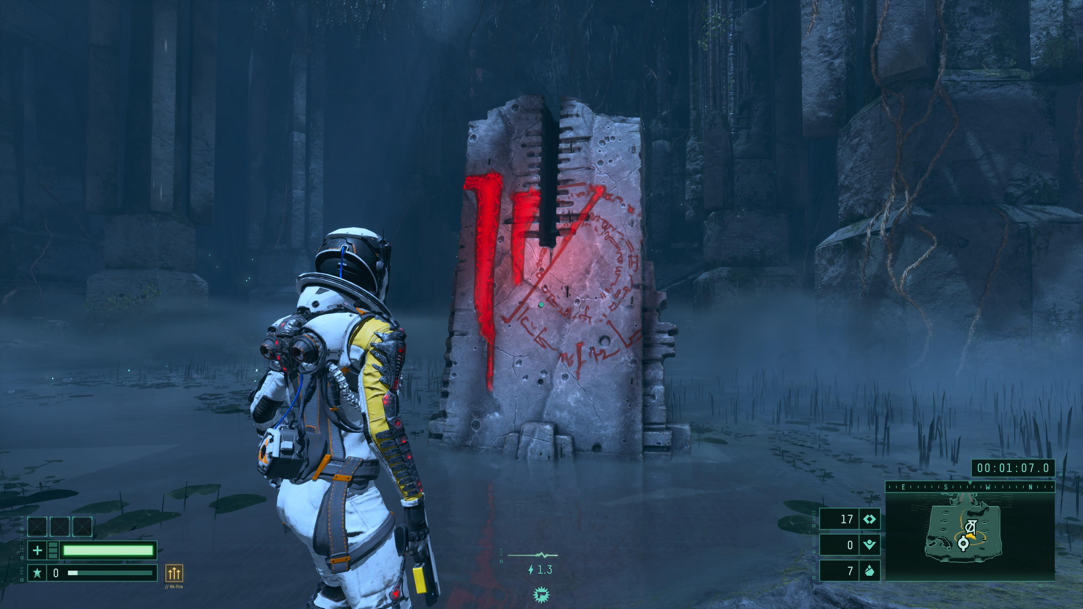

Slide 15
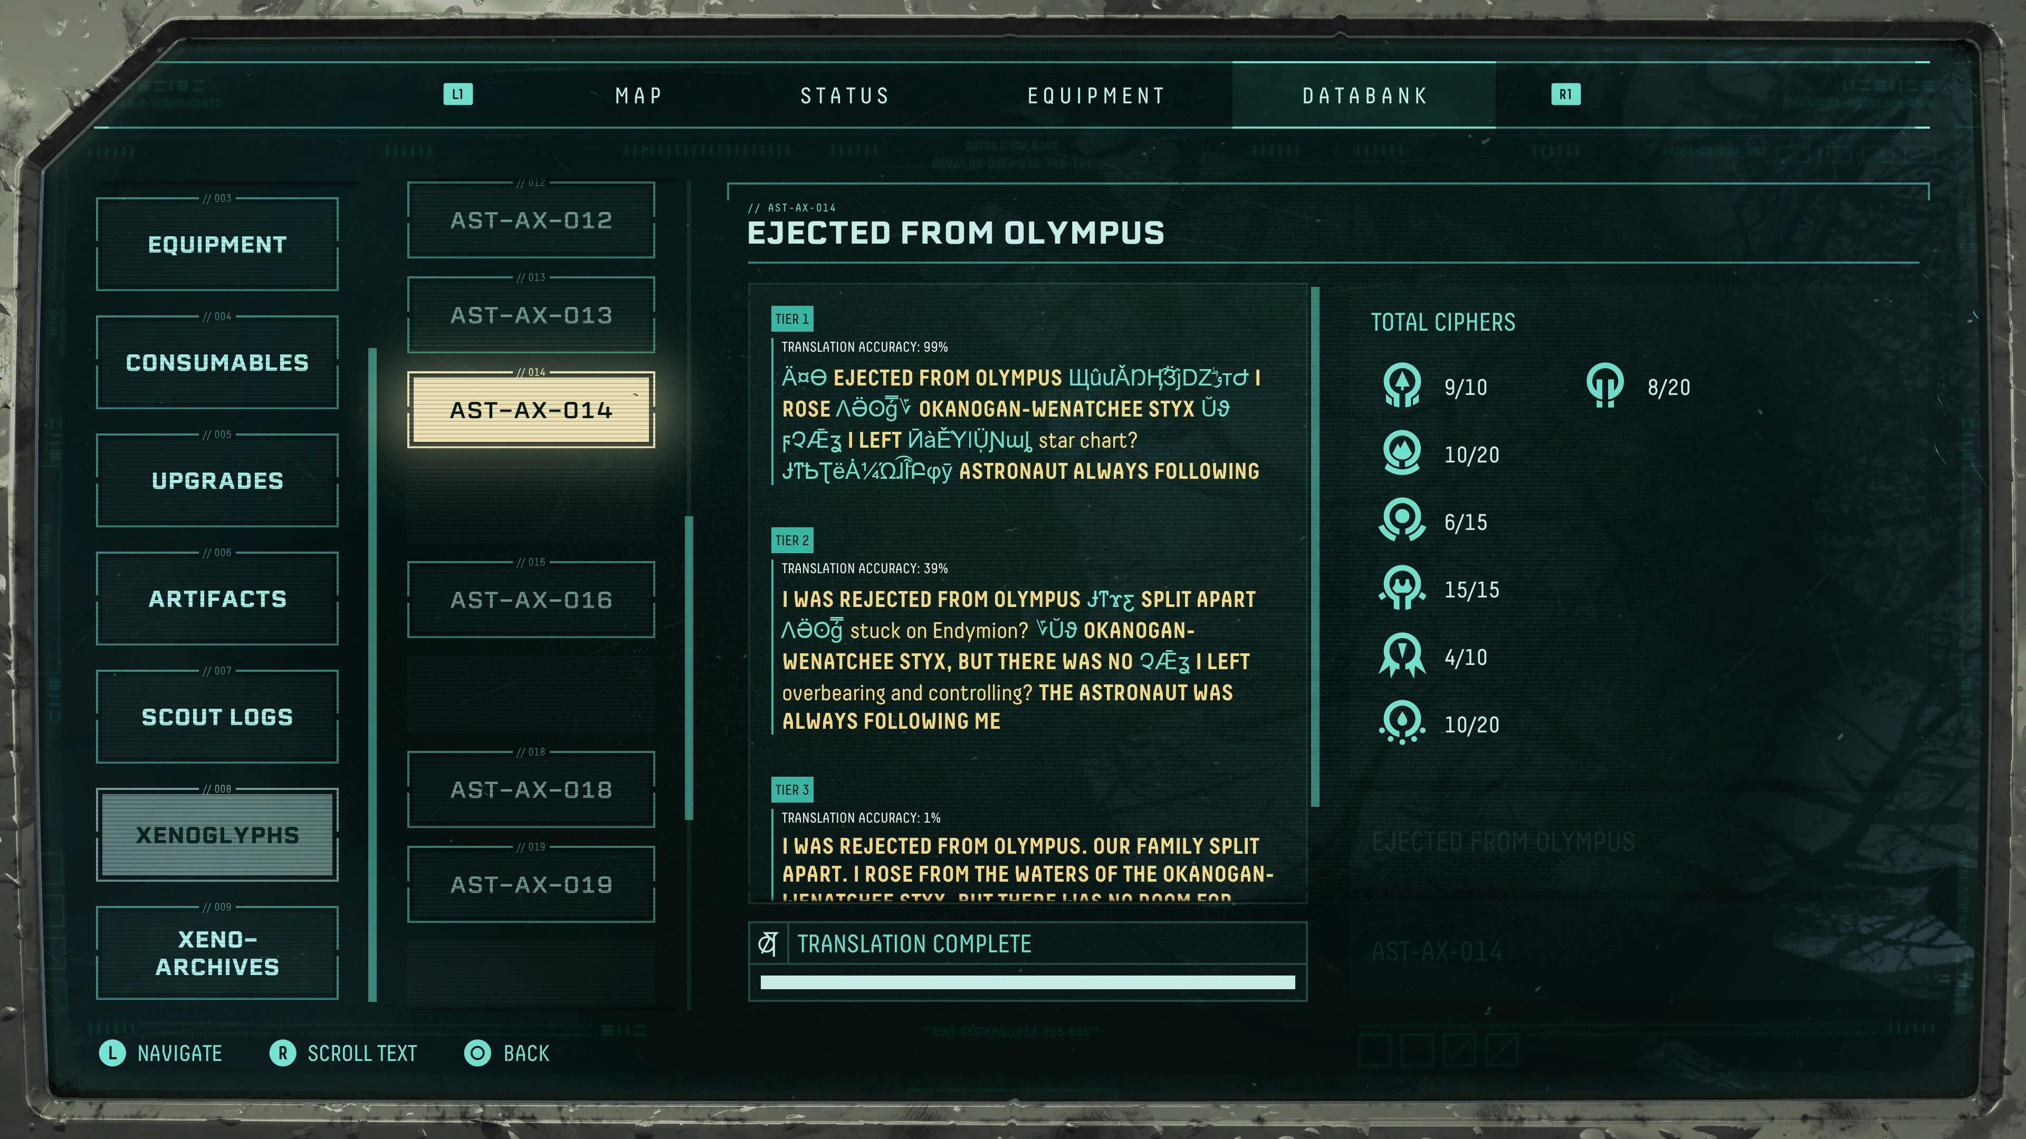
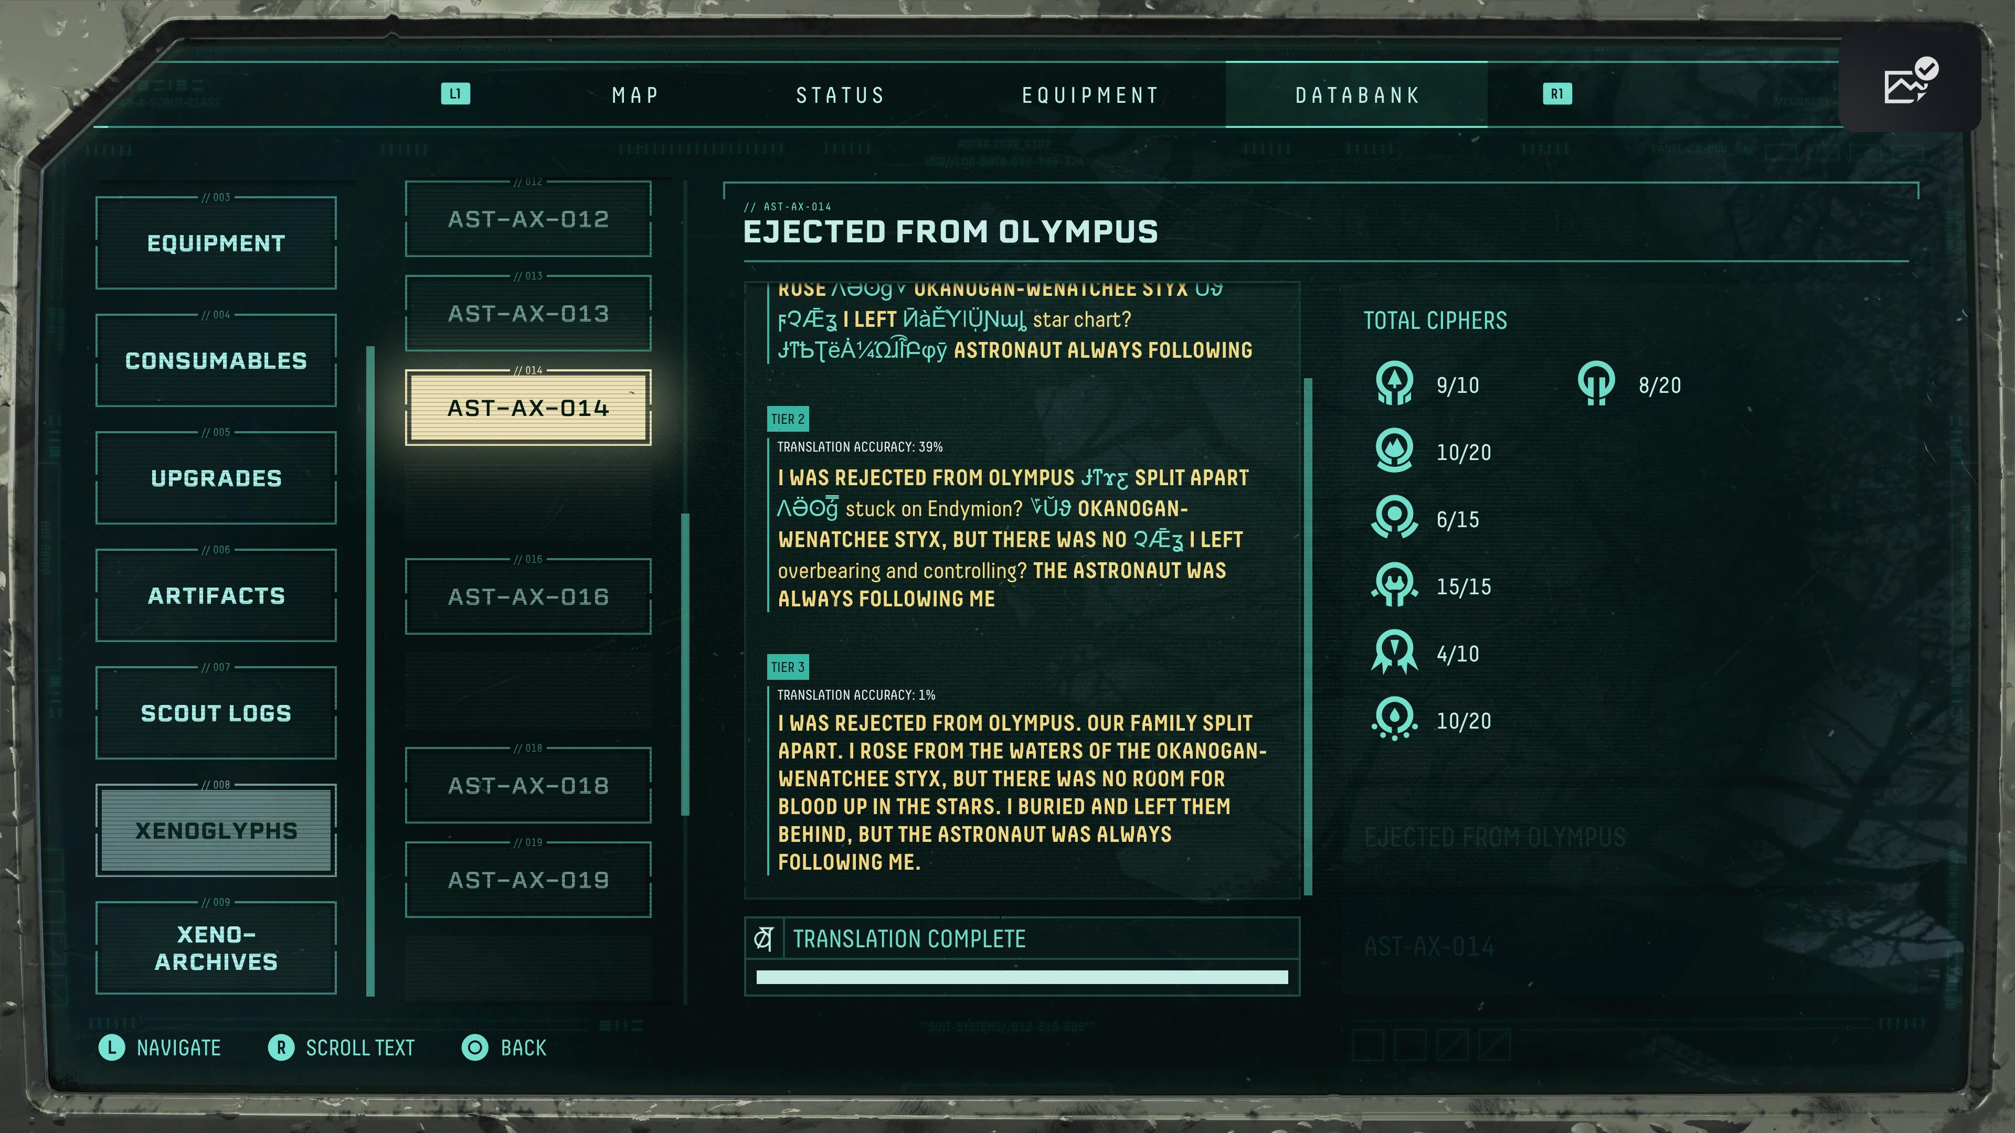

Slide 16
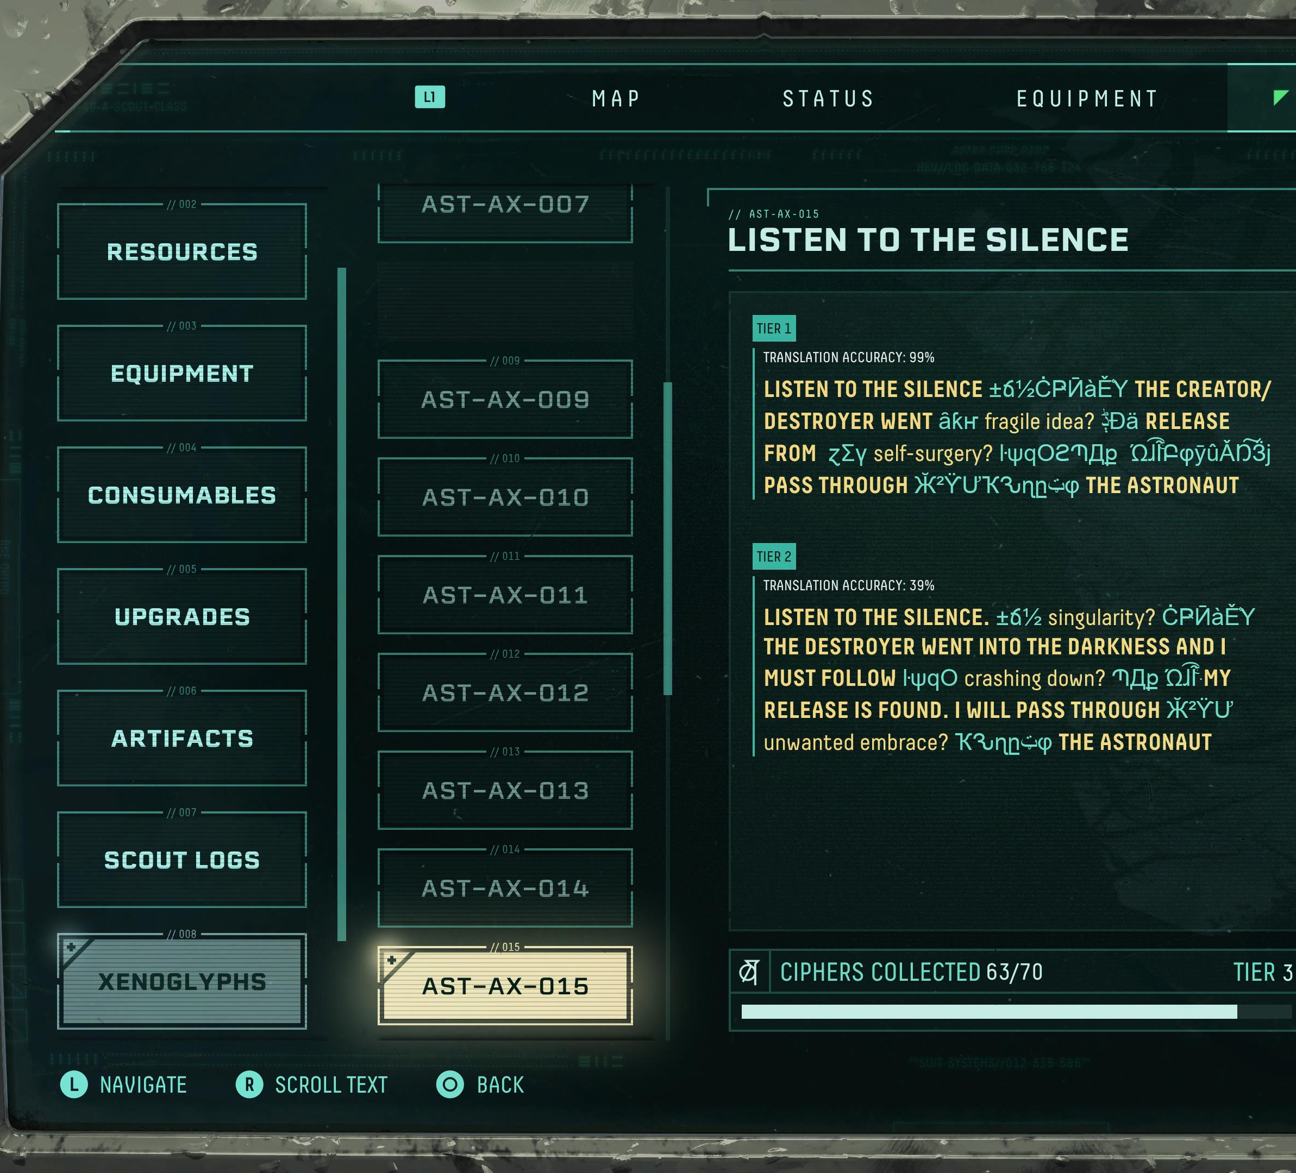
Tier 3
Translation Accuracy: 0%
LISTEN TO THE SILENCE, DEEPER THAN HADES AND BLACKER THAN TARTARUS: THE DESTROYER WENT INTO THE DARKNESS AND I MUST FOLLOW. THE UNIVERSAL GRAVE IS WHERE MY RELEASE IS FOUND. I WILL PASS THROUGH IT TO CONFRONT THE ASTRONAUT.

Slide 18
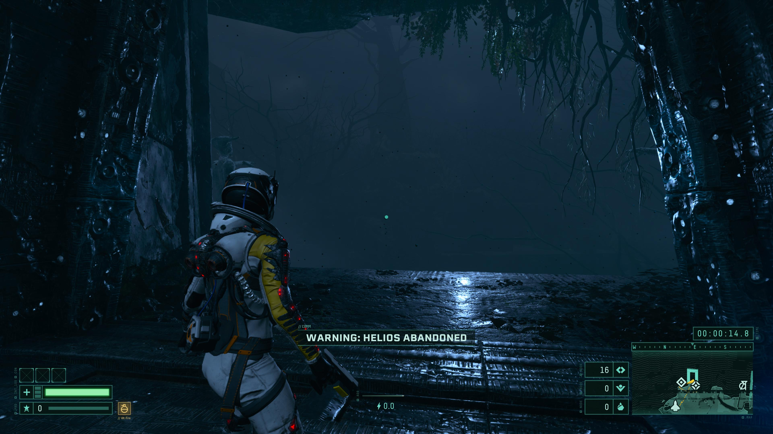

Slide 19
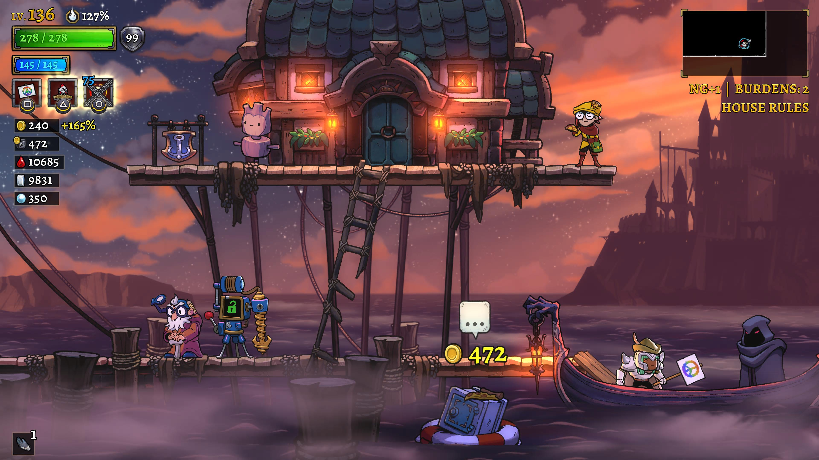
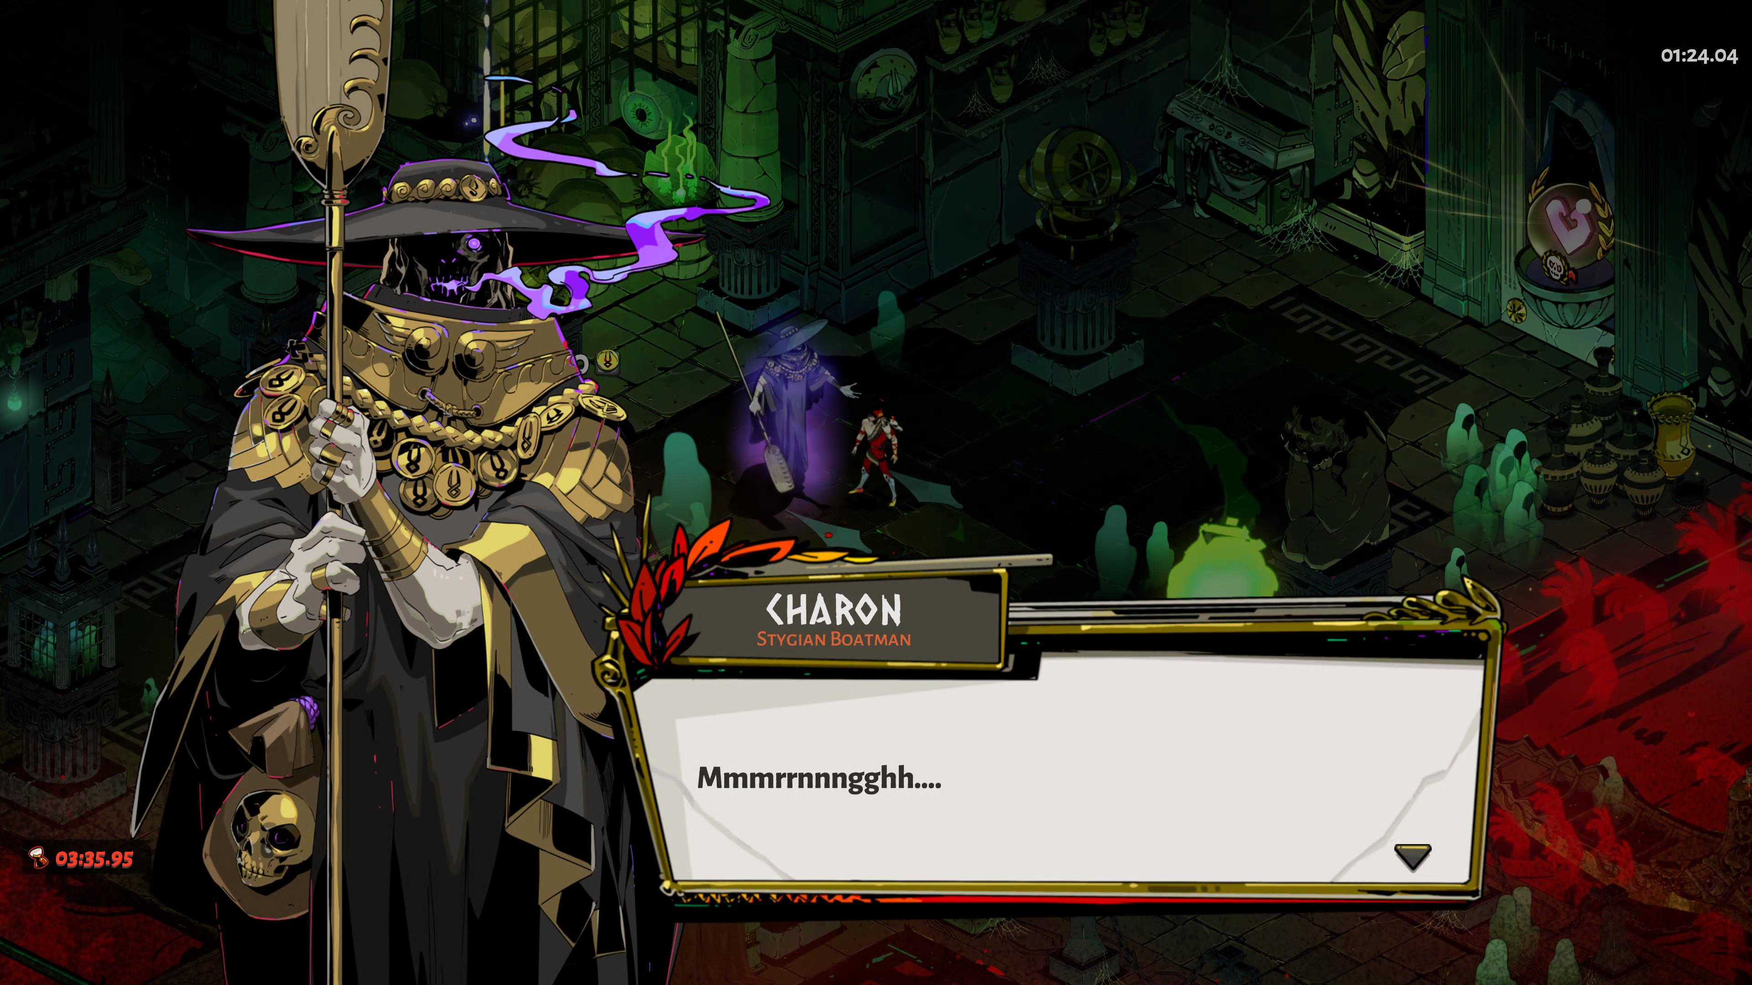

Charon, as he appears in Rogue Legacy 2 (left) and Hades (right)

Slide 20
Games and Works Cited
Games:
Hades, Supergiant Games, 2020
Returnal, Housemarque, 2021
Rogue Legacy 2, Cellar Door Games, 2022
Scholarship:
McMenomy, Mary. 2015. “Reading the Fiction of Video Games.” In The Reception of Ancient Greece and Rome in Children’s Literature: Heroes and Eagles, edited by Lisa Maurice. Brill.

